Slide 1
JOIN
Arif Muntasa

Slide 2
JOIN MODELS (1)
Inner Join
Natural Join
Left (Outer) Join
Right (Outer) Join
(Full) Outer Join

Slide 3
JOIN MODELS (2)
Left (Outer) Join Excluding Inner Join
Right (Outer) Join Excluding Inner Join
(Full) Outer Join Excluding Inner Join
Cross Join

Slide 4
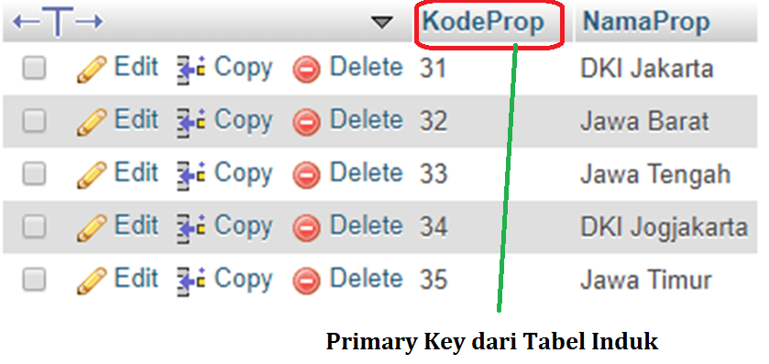
Tabel Induk Propinsi has 5 records

Slide 5
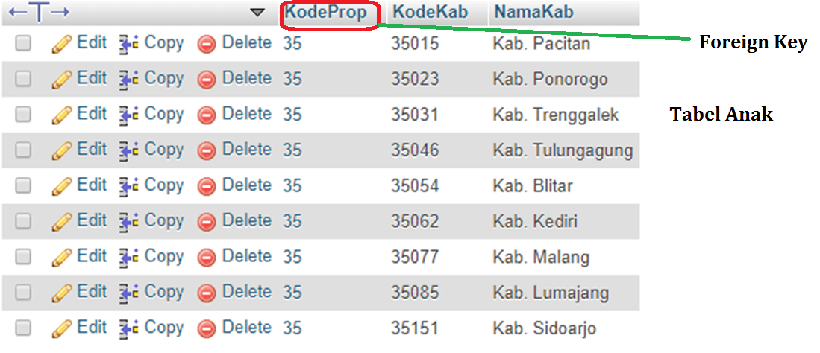
Tabel Anak Kabupaten has 9 records

Slide 6
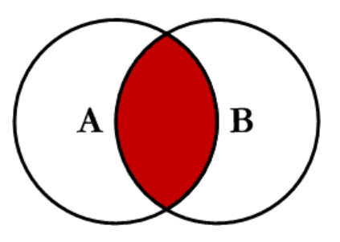
INNER JOIN

Slide 7
INNER JOIN SCRIPT
SELECT propinsi.*, kabupaten.*
FROM propinsi INNER JOIN kabupaten ON propinsi.KodeProp=kabupaten.KodeProp
Propinsi adalah tabel induk
Kabupaten adalah tablel anak

Slide 8
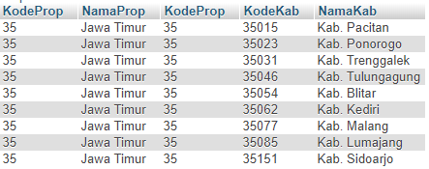
INNER JOIN RESULTS

Slide 9
INNER JOIN = NATURAL JOIN
SELECT propinsi.*, kabupaten.*
FROM propinsi, kabupaten
WHERE propinsi.KodeProp=kabupaten.KodeProp

Slide 10
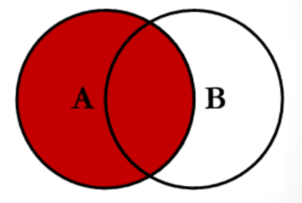
LEFT OUTER JOIN
Anak
Induk

Slide 11
LEFT OUTER JOIN SCRIPT
SELECT *
FROM propinsi
LEFT OUTER JOIN kabupaten
ON propinsi.KodeProp=kabupaten.KodeProp
Induk
Anak
LEFT OUTER JOIN on Anak
PK Induk = FK Anak

Slide 12
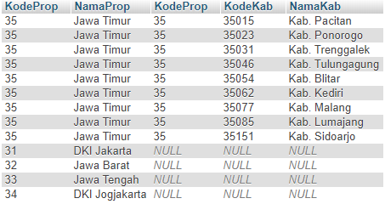
LEFT OUTER JOIN RESULTS
Anak
Induk

Slide 13
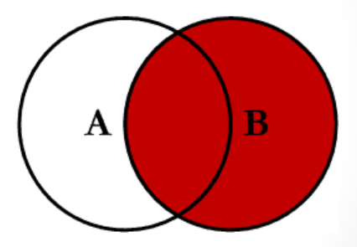
RIGHT OUTER JOIN
Anak
Induk
RIGHT OUTER JOIN on Anak
PK Induk = FK Anak

Slide 14
RIGHT OUTER SCRIPT
SELECT *
FROM propinsi
RIGHT OUTER JOIN kabupaten
ON propinsi.KodeProp=kabupaten.KodeProp
Induk
Anak
RIGHT OUTER JOIN on Anak
PK Induk = FK Anak

Slide 15
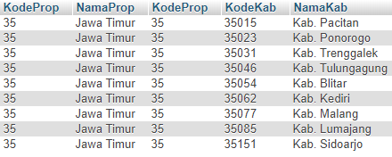
RIGHT OUTER RESULTS
Hanya yang match, record induk ditampilkan

Slide 16
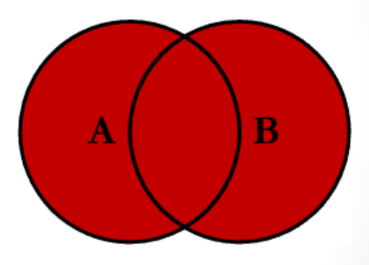
FULL OUTER JOIN
Anak
Induk
RIGHT OUTER JOIN on Anak
PK Induk = FK Anak

Slide 17
FULL OUTER JOIN
SQL don’t have FULL OUTER JOIN
It can be obtained by UNION “LEFT” and “RIGHT” OUTER JOIN

Slide 18
FULL OUTER JOIN SCRIPT
SELECT *
FROM propinsi
LEFT OUTER JOIN kabupaten
ON propinsi.KodeProp=kabupaten.KodeProp
UNION
SELECT *
FROM propinsi
RIGHT OUTER JOIN kabupaten
ON propinsi.KodeProp=kabupaten.KodeProp

Slide 19
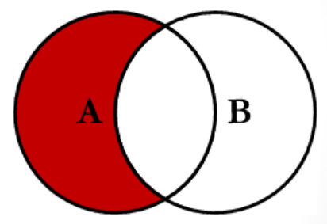
LEFT JOIN EXLUDING INNER JOIN
Dimiliki Oleh Induk, Anak tidak punya

Slide 20
LEFT JOIN EXLUDING INNER JOIN SCRIPT
SELECT *
FROM propinsi
LEFT OUTER JOIN kabupaten
ON propinsi.KodeProp=kabupaten.KodeProp
WHERE kabupaten.KodeProp IS NULL
Dimiliki Oleh Induk,
Anak tidak punya

Slide 21

LEFT JOIN EXLUDING INNER JOIN RESULTS
Dimiliki Oleh Induk,
Anak tidak punya

Slide 22
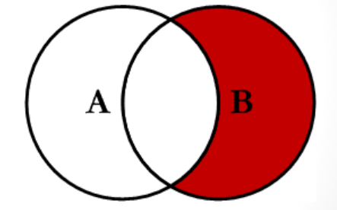
RIGHT JOIN EXLUDING INNER JOIN
Dimiliki Oleh Anak, Induk tidak punya

Slide 23
RIGHT JOIN EXLUDING INNER JOIN SCRIPT
SELECT *
FROM propinsi
RIGHT OUTER JOIN kabupaten
ON propinsi.KodeProp=kabupaten.KodeProp
WHERE propinsi.KodeProp IS NULL
Dimiliki Oleh Anak, Induk tidak punya

Slide 24
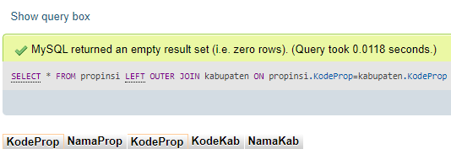
RIGHT JOIN EXLUDING INNER JOIN RESULTS

Slide 25
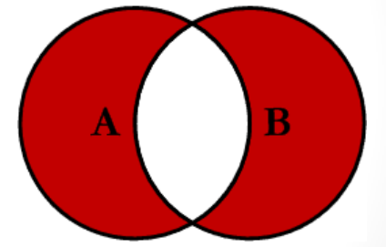
FULL OUTER EXLUDING INNER JOIN
LEFT JOIN EXLUDING INNER JOIN
RIGT JOIN EXLUDING INNER JOIN

Slide 26
FULL OUTER EXLUDING INNER JOIN
LEFT JOIN EXLUDING INNER JOIN
union
RIGHT JOIN EXLUDING INNER JOIN

Slide 27
FULL OUTER EXLUDING INNER JOIN SCRIPT
LEFT JOIN EXLUDING INNER JOIN
SELECT *
FROM propinsi
LEFT OUTER JOIN kabupaten
ON propinsi.KodeProp=kabupaten.KodeProp
WHERE kabupaten.KodeProp IS NULL
UNION
SELECT *
FROM propinsi
LEFT OUTER JOIN kabupaten
ON propinsi.KodeProp=kabupaten.KodeProp
WHERE propinsi.KodeProp IS NULL
RIGT JOIN EXLUDING INNER JOIN

Slide 28

FULL OUTER EXLUDING INNER JOIN RESULTS

Slide 29
CROSS JOIN
A cross join can be defined every record in Table A combined with every record in Table B

Slide 30
CROSS JOIN SCRIPT
SELECT * from propinsi CROSS JOIN kabupaten;

Slide 31
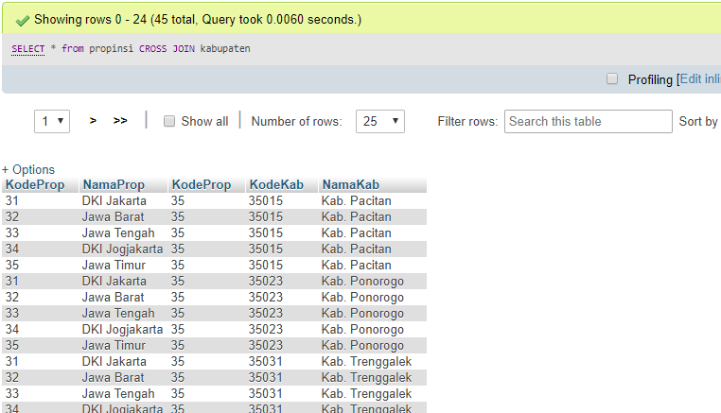
PROPINSI CROSS JOIN KABUPATEN

